Slide 1
Hepatitis C:
The Silent Epidemic
Bruce D. Askey, MS, ANP-BC
Adult Nurse Practitioner
Dept. of Hepatology/Gastroenterology
Guthrie Clinic
Sayre, PA/Ithaca, NY

Slide 2
Objectives
By the end of the presentation, the participant will:
  Verbalize risk factors for hepatitis C.
  Identify appropriate screening populations and diagnostic tests for hepatitis C.
  State potential complications of hepatitis C.

Slide 3
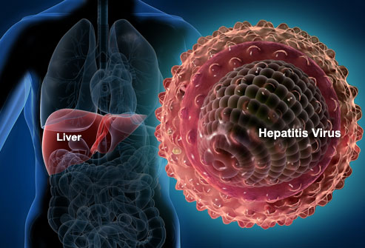

Slide 4
Hepatitis
Inflammation of the liver
  Presents with elevation of liver enzymes
Infectious or noninfectious
  Acute or chronic

Slide 5
Infectious Hepatitis
Hepatitis A
Hepatitis B
Non-A; non-B
  Hepatitis C
  Hepatitis D
  Hepatitis E
  Hepatitis G
  Hepatitis ?

Slide 6
Comparing HBV and HCV
HBV
  DNA virus
  Found in all body fluids
  Commonly sexually transmitted
  Transmitted through sharing drug paraphernalia
  Vaccine available
      Source- Lok, A & McMahon, J. 2009. Chronic Hepatitis B: Update 2009. Hepatology. 50(3):1-36.

Slide 7
Comparing HBV and HCV (continued)
HCV
  RNA virus
  Found primarily in the blood
  Rarely sexually transmitted
  Transmitted through sharing drug paraphernalia
  Vaccine not available
      Source- Ghany, M, et al., 2009. Diagnosis, Management and Treatment of Hepatitis C: An update. Hepatology. 49(4):1335-1374.

Slide 8
Hepatitis C
The most common chronic blood-borne infection in the US.
  #1 reason for liver transplant in the US
10-20% will develop cirrhosis 20-30 years after exposure.
Up to 5% will develop liver cancer.
      Source- Wise, M, et al., Hepatology. 2008;47:1128-1135

Slide 9
Hepatitis C
(continued)
15% of those exposed will clear spontaneously but retain the hepatitis C antibody. (85% will remain viremic.)
Leading cause of death in HIV patients
  4 million Americans have HCV.
      Source- Wise, M, et al., Hepatology. 2008;47:1128-1135

Slide 10
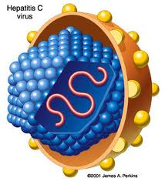

Slide 11
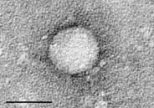

Slide 12
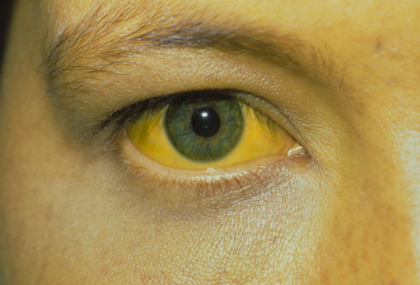
Symptoms of HCV
Acute infection (<6 months)
  Generally asymptomatic, but jaundice occurs in 20% of cases.

Slide 13
Symptoms of HCV (cont.)
Chronic infection (>6 months)
  Generally asymptomatic, but may have elevated liver enzymes.
Advanced disease
  Ascites, varices, encephalopathy

Slide 14
Asymptomatic Disease in HCV
75% are undiagnosed.
80% are asymptomatic.
End stage liver disease generally occurs 20 years after exposure.

Slide 15
Risk Factors for HCV
Clotting factors prior to 1987
  85%
Injection drug use
  80%
Hemodialysis
  10-20%
Multiple sex partners
  4-6%

Slide 16
Risk Factors for HCV
(continued)
Sexual contact with infected partner
  2-3%
Blood transfusion prior to July 1992
  5%
Infants born to infected women
  4-7%

Slide 17
Risk Factors for HCV
(continued)
Organ recipients prior to 1992
  5%
Healthcare workers (needle stick, etc.)
  2%
      Source- Ghany, M, et al., 2009. Diagnosis, Management and Treatment of Hepatitis C: An update. Hepatology. 49(4):1335-1374.

Slide 18

Possible Risk Factor

Slide 19
Diagnosis of Hepatitis C
Health history
  Most reliable method available to assess risk
Physical exam
  Not reliable!!!
Abnormal liver enzymes (ALT)
  Not reliable!!!

Slide 20
Diagnosis of Hepatitis C (continued)
Hepatitis C antibody
  Indicates exposure (15% have cleared.)
Hep C RNA by PCR (Heptimax®)
  Indicates current infection
  Viral load (benchmark)
      Source- Ghany, M, et al., 2009. Diagnosis, Management and Treatment of Hepatitis C: An update. Hepatology. 49(4):1335-1374.

Slide 21
Who to Screen
Anyone with a risk factor for hepatitis C
Anyone with elevated liver enzymes
      Source- Kuritzky L, et al. Family Practice Recertification. 2006; 28(2)41-57.

Slide 22
Who to Screen
(continued)
Those born between 1945-1965 (baby boomers) should be offered a 1 time screening for hepatitis C.
  5 times more likely than other adults to have hepatitis C
  75% of adults with hepatitis C are baby boomers.
      Source- http://www.cdc.gov/features/HepatitisCTesting/index.html, accessed 3.7.13.

Slide 23
Diagnostic Codes
Abnormal liver enzymes: 794.8
Acute hepatitis C: 070.51
Chronic hepatitis C: 070.54
Exposure to hepatitis: V01.8

Slide 24

Serologic Tests
Hepatitis C antibody
Hepatitis C RNA
Hepatitis C genotype
Liver biopsy

Slide 25
Serologic Tests
(continued)
Hepatitis C antibody
  Screening test for exposure to HC
  Immune cell that is made to fight off HC
  All of those exposed will generate an antibody but 15% will clear the virus.
  85% of those with an antibody will be currently infected.
      Source- Ghany, M, et al., 2009. Diagnosis, Management and Treatment of Hepatitis C: An update. Hepatology. 49(4):1335-1374.

Slide 26
Serologic Tests
(continued)
Hepatitis C RNA
  “Viral load”
  Indicates current infection
  Value does not correlate with degree of liver damage or clinical symptoms
      Source- Ghany, M, et al., 2009. Diagnosis, Management and Treatment of Hepatitis C: An update. Hepatology. 49(4):1335-1374.

Slide 27
Serologic Tests
(continued)
Hepatitis C genotype
  There are 6 forms (genotypes) of HC.
  Genotype 1 is the most common in the US.
  With current therapies the response rates are similar regardless of genotype
      Source- Flamm SL. JAMA. 2003; 289:2413-2417.

Slide 28
Serologic Tests
(continued)
Liver biopsy
  Allows staging of liver disease
  Rules out autoimmune hepatitis

Slide 29
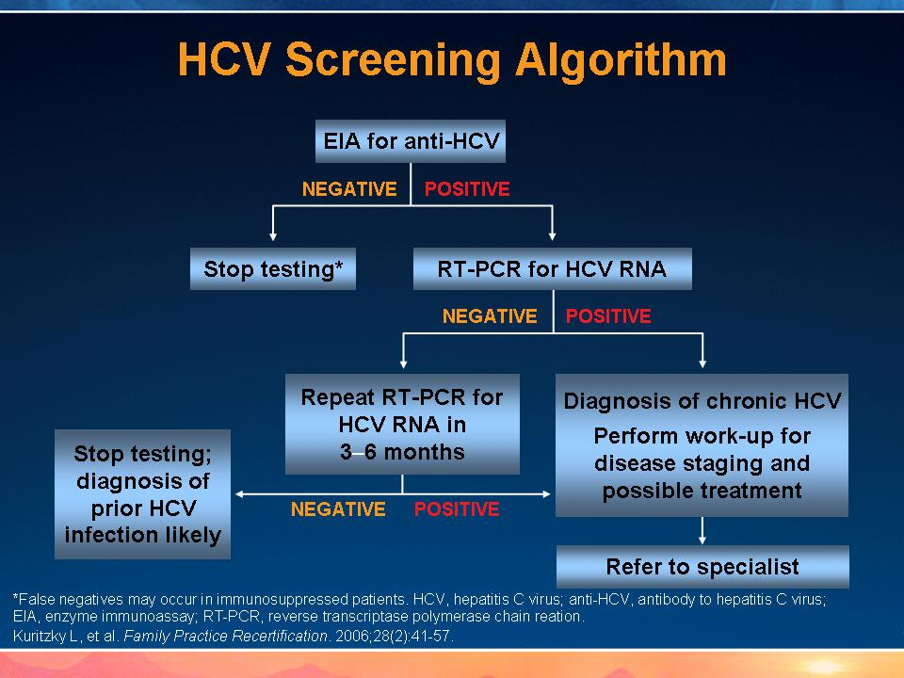

Slide 30
Factors Causing Rapid Progression of Liver Disease in HC
Alcohol use
Obesity/fatty liver
HIV infection
Hepatitis B infection
Male gender
      Source- Bialek SR, et al., Clin Liv Dis. 2006; 10:697-715.

Slide 31
Factors Not
Influencing Progression
Alanine aminotransferase level (ALT)
Viral load
Mode of transmission
Genotype
      Source- NIH Consensus Development Conference Statement. 2002.Poynard et al. Lancet. 1997;349:825-832.
Notes:
31
Factors Not Influencing Progression
Key Points In contrast to older age at acquisition of HCV, male gender, and consumption of alcohol, fibrosis progression was not associated with viremia, genotype, mode of transmission, or ALT levels.
Genotype, including genotype 1b, and high versus low viremia showed no association with fibrosis progression. This lack of association remained when comparing by age strata. Of those infected with HCV genotype 1b, the rate of fibrosis was higher in patients over 40 years of age than in the younger patients. There was no significant difference in stage of fibrosis between HCV genotypes, including 1b versus other genotypes. Regarding viremia, the investigators point out that these observations were determined by comparison with biopsy samples for 50% of the subjects and the sample size was small. Thus, they urge cautious interpretation of the lack of an association between viremia and fibrosis progression. Alanine aminotransferase (ALT) is only weakly correlated with disease severity and ALT levels are insensitive for detecting disease progression.
References
National Institutes of Health Consensus Development Conference Statement. Management of hepatitis C: 2002. Bethesda, Md: National Institutes of Health; June 10-12, 2002.
Poynard T, Bedrossa P, Opolon P, for the OBSVIRC, METAVIR, CLINIVIR, and DOSVIRC group. Randomised trial of interferon alfa-2b plus ribavirin for 48 weeks or for 24 weeks versus interferon alfa-2b plus placebo for 48 weeks for treatment of chronic infection with hepatitis C. Lancet. 1997;349:825-832.

Slide 32
Historical Management of Hepatitis C

Slide 33
Goals of Antiviral Therapy
Primary goal
  Eradicate HCV infection (possible in 80% of cases)
Secondary goals
  Slow disease progression
  Improve histology
  Reduce risk of hepatocellular carcinoma
  Improve health-related quality of life
      Source- Ghany, M, et al., 2009. Diagnosis, Management and Treatment of Hepatitis C: An update. Hepatology. 49(4):1335-1374.
Notes:
33
Goals of Therapy
Two goals are clinically relevant for treatment of HCV. The primary goal is the eradication of the virus as evidenced by negative HCV RNA. The secondary goals include the histologic improvement of hepatic inflammation and fibrosis as evidenced by delayed fibrosis and progression to cirrhosis and prevention of hepatic decompensation and HCC.

Slide 34
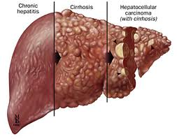

Slide 35
Historic Management of HC
Interferon
  Innate immune chemical that has antiviral properties
  “Boosts” the immune system and recruits other immune cells
    Histamine, interleukins, bradykinins, etc.
  <10% effective in eradicating HC
      Source- McHutchison JG, et al., N Engl J Med. 1998;352:1485-1492.

Slide 36
Historic Management of HC (continued)
Ribavirin
  1998
  Mechanism of action unknown
  Ineffective as monotherapy
  Close to 50% effective in eradicating HC when used in combination with interferon
      Source- McHutchison JG, et al., N Engl J Med. 1998;352:1485-1492.

Slide 37
Historic Management of HC (continued)
Pegylated interferon
  2001
  Used in combination with ribavirin
  A molecule of polyethylene glycol was added to the interferon, prolonging its action.
  <50% effective in eradicating genotype 1 HC and >70% effective at eradicating genotype 2/3
      Source- Hadziyannis SJ, et al., Ann Intern Med. 2004;140:346-355.

Slide 38
Historic Management of HC (continued)
Direct acting antivirals
  2011
  Boceprevir (Victrelis®), telaprevir (Incivek®)
  Approved for genotype 1 virus only
  Approved only in combination with pegylated interferon and ribavirin
  Up to 80% cure rate in genotype 1 disease
      Source- Ghany, M, et al., 2011. An Update on Treatment of Genotype 1 Chronic Hepatitis C Virus Infection: 2011 practice guideline by the American Association for the Study of Liver Diseases. Hepatology. 54 (4): 1433-1444.

Slide 39
Additional Considerations with Direct Acting Antivirals
Must be given with pegylated interferon and ribavirin
Must avoid missing doses as resistance rapidly occurs
Increased anemia
Rash

Slide 40
Case Study
Mr. J is a 43 year-old who presents to you as a new patient for primary healthcare needs. As part of his health history, he reveals that he had a blood transfusion in 1983.
What test should be drawn that would indicate exposure to hepatitis C?

Slide 41
Hepatitis C antibody is positive.
What is the percentage chance that he is currently infected?
What test would indicate current infection with hepatitis C?

Slide 42
Viral Load Testing Indicates Current Infection
What test will determine duration of treatment and chance of responding?

Slide 43
Additional Measures to Consider in the Management of
Chronic Hepatitis C
Hepatoma screening
  Cirrhotic or chronic hepatitis B
    Ultrasound and alpha-fetoprotein q 6 months
Alcohol avoidance
Weight reduction

Slide 44

Vaccinate for Hepatitis A and B

Slide 45
???

